Slide 1
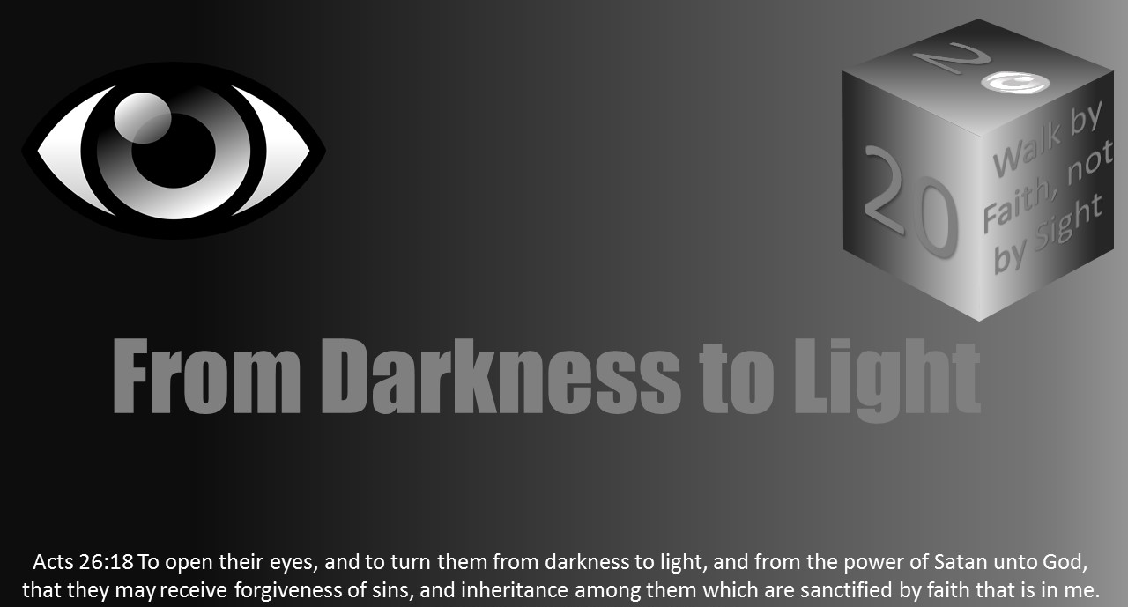


Slide 2
Light Lesson 2 A Story of Light: Part 2

Slide 3
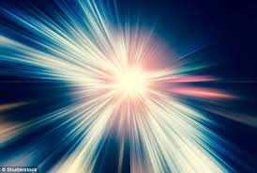
Introduction
In the previous lesson, we learned part of the light story.
In the beginning, God created light.
God is light.
Light is multifaceted and many splendored. It is quiet, unhurried, and powerful.
Since the Garden of Eden, Satan has been deceiving humanity's eyes and ears with his lies, such that human eyes are darkened.
Christ came to cure spiritual blindness and open eyes to see the spiritual rather than the temporal.
Once one can focus and make their eyes single, then these “children of light” must keep their focus on Christ and God.
Jesus healed the blind then, and He cures spiritual blindness now.
Let us continue the story of light.

Slide 4
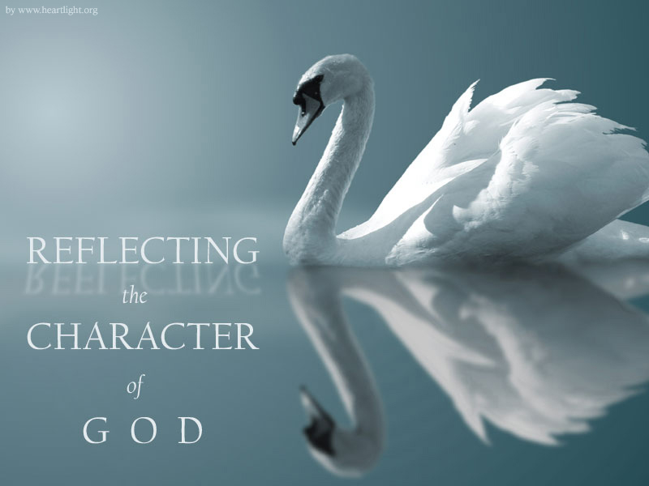
Reflecting God’s Light
As a child of the light, we seek to keep our focus on Jesus and to imitate Him.
Our goal is to be His image bearer as we are transformed in obedience through the renewing of our mind to righteousness and holiness (Rom 12:1-2, Ephes 4:23ff).
So in the mind’s eye, when one thinks of God and Christ and heaven from many passages, the idea of a strong pure white light often comes to mind.
Hebrews 1:3 records, “Who being the brightness of his glory, and the express image of his person, and upholding all things by the word of his power, when he had by himself purged our sins, sat down on the right hand of the Majesty on high.”
Revelation 1:16 records, “And he had in his right hand seven stars: and out of his mouth went a sharp two edged sword: and his countenance was as the sun shineth in his strength.”
2 Corinthians 4:6 reads, “For God, who commanded the light to shine out of darkness, hath shined in our hearts, to give the light of the knowledge of the glory of God in the face of Jesus Christ.”
Other passages such as Matthew 28:3 and Revelation 4, give a finite mind the idea again of pure white, overpowering light.

Slide 5
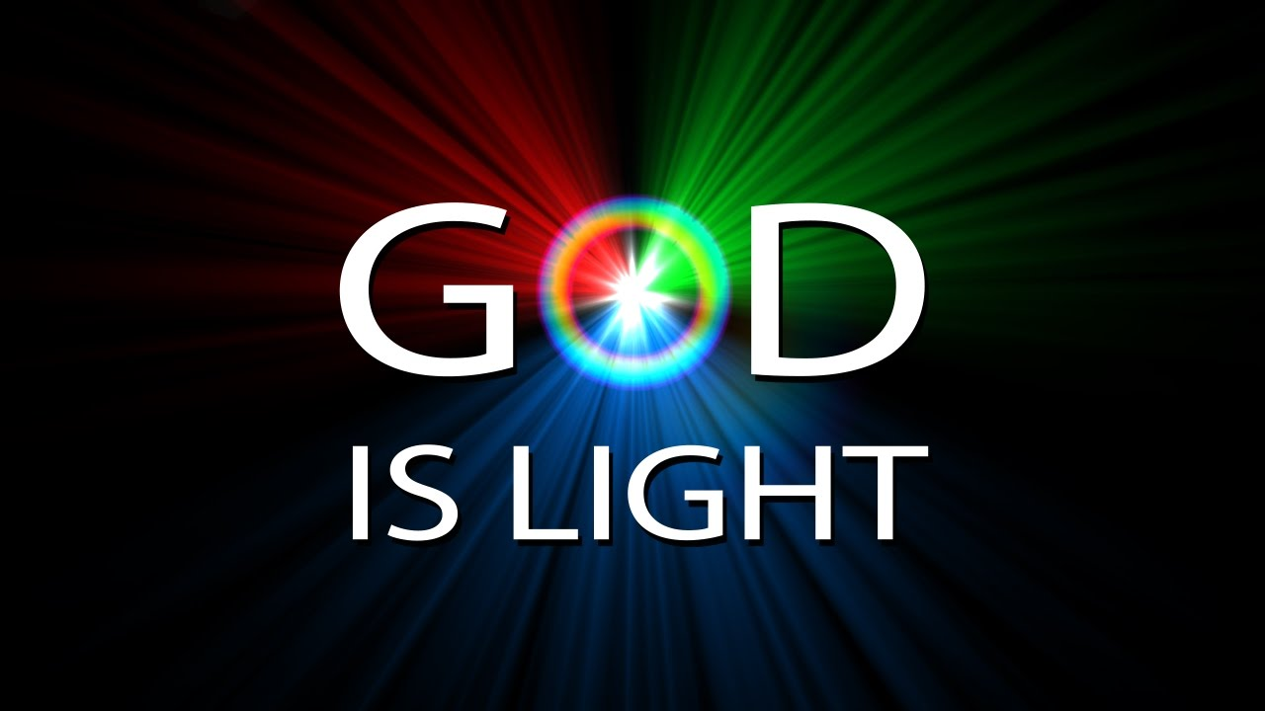
Reflecting God’s Light
God is light.
Christ is the express image and the brightness of His glory.
Christians are called to imitate Jesus, to be holy, and share the light of the gospel.
Christians are God’s image bearers to the world.
The most powerful light to the human senses is the sun.
In the mind’s eye of understanding, we can see God as the sun and the rays of the sun as Christ. Christians are the reflecting surface or mirror of that “light.”
People might not understand or be able to see if their mirror is dull. (If you have never seen an old mirror, please observe the difference in the mirrors more in use now.)

Slide 6
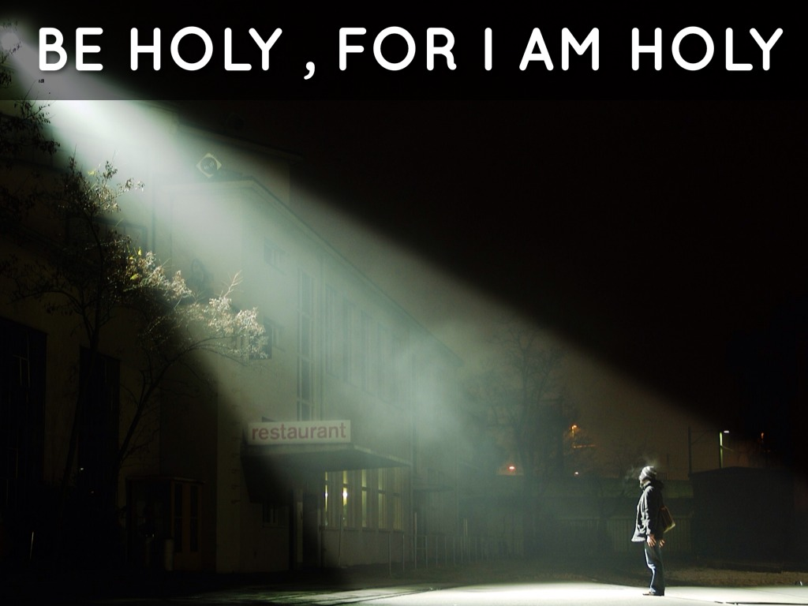
Reflecting God’s Light
Thinking of God as light, we should see the intrinsic quality of God is holiness.
Folks use words like “righteousness” and “holiness” without really contemplating the word’s meaning it seems.
In God’s word, we read God is love. We read God is light. However, God is also called “holy, holy, holy.” The scriptures do not use this repetition without purpose.
This is the very quality or nature of God.
He commanded his children to be holy because He is holy, holy, holy.
He calls Christians to partake of his divine nature and holiness.
He instructs His followers to perfect holiness. (See 1 Cor 13:12; 2 Cor 3:18; Heb 1:3; 1 Cor 15:49; Col 1:15; Col 3:10; Rom 8:29; 2 Cor 4:4; 2 Cor 7:1; Eph 4:24; 1 Thes 4:9; Heb 12:10; 1 Pet 1:15-16; Isa 6:3; and Rev 4:8.)

Slide 7
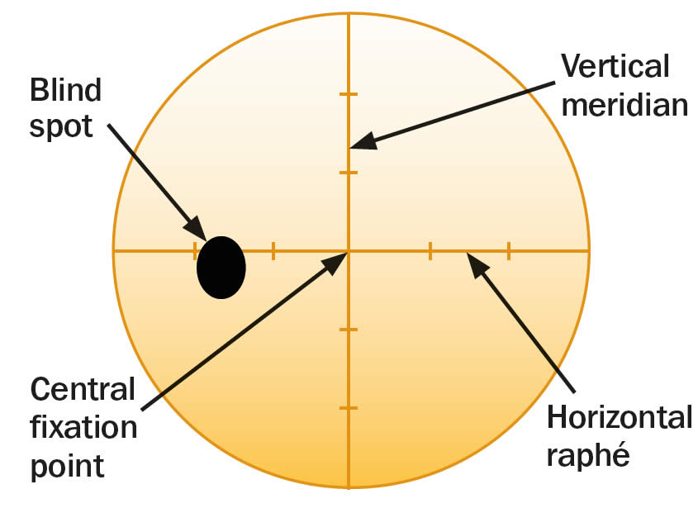
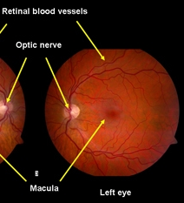
Blind spots
Human eyes have blind spots. The key part of the human eye is the macula (or fovea centralis). It is where the best reading and driving vision are located. This is where humans get their 20/20 vision. Diseases in the macula like macular degeneration cause damage that yields vision loss.
However, just across the back of the eye from the macula is the optic nerve head. From the optic nerve head, all the nerves spread throughout the back of the eye. The optic nerve carries information from the eye to the brain and from the brain to the eyes. Humans could not see without the optic nerve. Diseases such as glaucoma cause damage to the optic nerve. Thus, we cannot see without an optic nerve to carry the image to the brain, but we cannot see with the optic nerve as it does not gather image information as the photoreceptor cells.
The optic nerve is a place in the back of the eye where there are no photoreceptors. Thus, it is a blind spot, even though it is busy carrying information to and from the brain. Eye care doctors use this as reference for tests frequently.

Slide 8
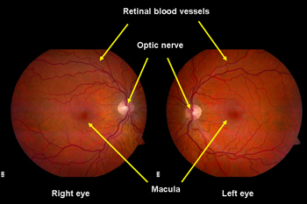
Blind spots
It is easy for Christians to have blind spots to sin.
Sometimes we are self-righteous or justify ourselves.
Sometimes, we exist in hypocrisy.
It is often the lie of Satan or one that we have told ourselves.
Christians often wrongfully try to compare themselves with others as a false standard.

Slide 9
Blind spots
Paul spoke of Jewish teachers in Romans 2:19 as “...confident that thou thyself art a guide of the blind, a light of them which are in darkness.”
Similarly, Jesus challenged the scribes and Pharisees to see their blindness, “Woe unto you, ye blind guides, which say, Whosoever shall swear by the temple, it is nothing; but whosoever shall swear by the gold of the temple, he is a debtor! Ye fools and blind: for whether is greater, the gold, or the temple that sanctifieth the gold? And, Whosoever shall swear by the altar, it is nothing; but whosoever sweareth by the gift that is upon it, he is guilty. Ye fools and blind: for whether is greater, the gift, or the altar that sanctifieth the gift?" (Matt 23:16-19).
He continued in v23-28 “Woe unto you, scribes and Pharisees, hypocrites! for ye pay tithe of mint and anise and cummin, and have omitted the weightier matters of the law, judgment, mercy, and faith: these ought ye to have done, and not to leave the other undone. Ye blind guides, which strain at a gnat, and swallow a camel. Woe unto you, scribes and Pharisees, hypocrites! for ye make clean the outside of the cup and of the platter, but within they are full of extortion and excess. Thou blind Pharisee, cleanse first that which is within the cup and platter, that the outside of them may be clean also. Woe unto you, scribes and Pharisees, hypocrites! for ye are like unto whited sepulchres, which indeed appear beautiful outward, but are within full of dead men's bones, and of all uncleanness. Even so ye also outwardly appear righteous unto men, but within ye are full of hypocrisy and iniquity.”

Slide 10
Blind spots
The scribes and Pharisees were the blind leading the blind.
They taught the commandments of men.
Matthew 15:14 describes the scribes and Pharisees, “Let them alone: they be blind leaders of the blind. And if the blind lead the blind, both shall fall into the ditch.”
These leaders did not care for the lost.
They cared about their place, power, and position.
It was not selfless but selfishness that motivated them.
Their worship of God was vain as they honored God with their lips, but their heart was far removed.

Slide 11
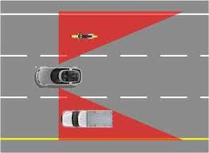
Blind spots
Can this be Christians today? Absolutely!
This author calls it the “Baptized Believer Syndrome.”
Members of the church act as though they think they cannot fall, even though Israel did (Heb 3:12-4:2).
The church often seems to un-vocally say that baptism alone is going to save you, even though it alone will not (1 Cor 10:1-12).
Like Israel, children of God can fall because of idolatry (covetousness), sexual immorality, testing Christ, and grumbling.
Try finding an eye’s blind spot with an Amsler grid you downloaded.

Slide 12
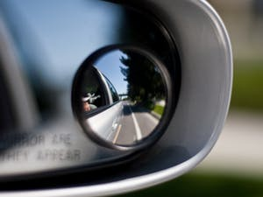
Blind spots
Sometimes our blind spots are specific to our individual weaknesses.
Christians need to be vulnerable enough to confess these things so that others can help them.
Christians need help from one another.
It is shameful to allow past sin to keep us from confession and seeking heaven.
Is it the pride of life that keeps us from confessing sin and seeking help from escaping it? Everyone needs helps.
Real strength and real struggle call on others to aid in the battle of obedience.
If our house was on fire, would we be resistant to asking the neighbor for help to call the fire department?

Slide 13

Walk by Faith Not by Sight
2 Corinthians 5:7 reads, “For we walk by faith, not by sight.”
Human sight and eyes can be fooled by quick hands and optical illusions.
In fact, the brain often completes gaps in human vision. Consider a few optical illusions of how the eye and brain can be fooled.
The silhouette illusion can be two faces or a vase.

Slide 14

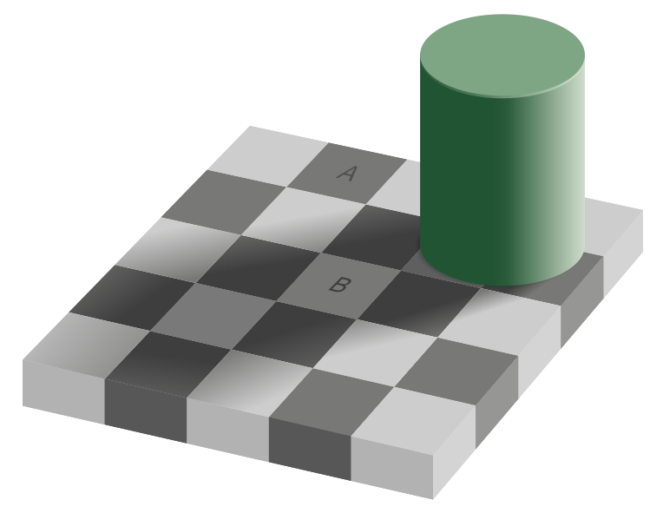

Walk by Faith Not by Sight
The simultaneous contrast illusion has a gradient background that progresses from dark grey to light grey. The horizontal bar appears to progress from light gray to dark gray, but it is in fact just one color.
The checker shadow illusion also fools the eyes. Although square A appears a darker shade of grey than square B, in the image, the two have exactly the same luminance. Drawing a connecting bar between the two squares breaks the illusion and shows that they are the same shade.

Slide 15
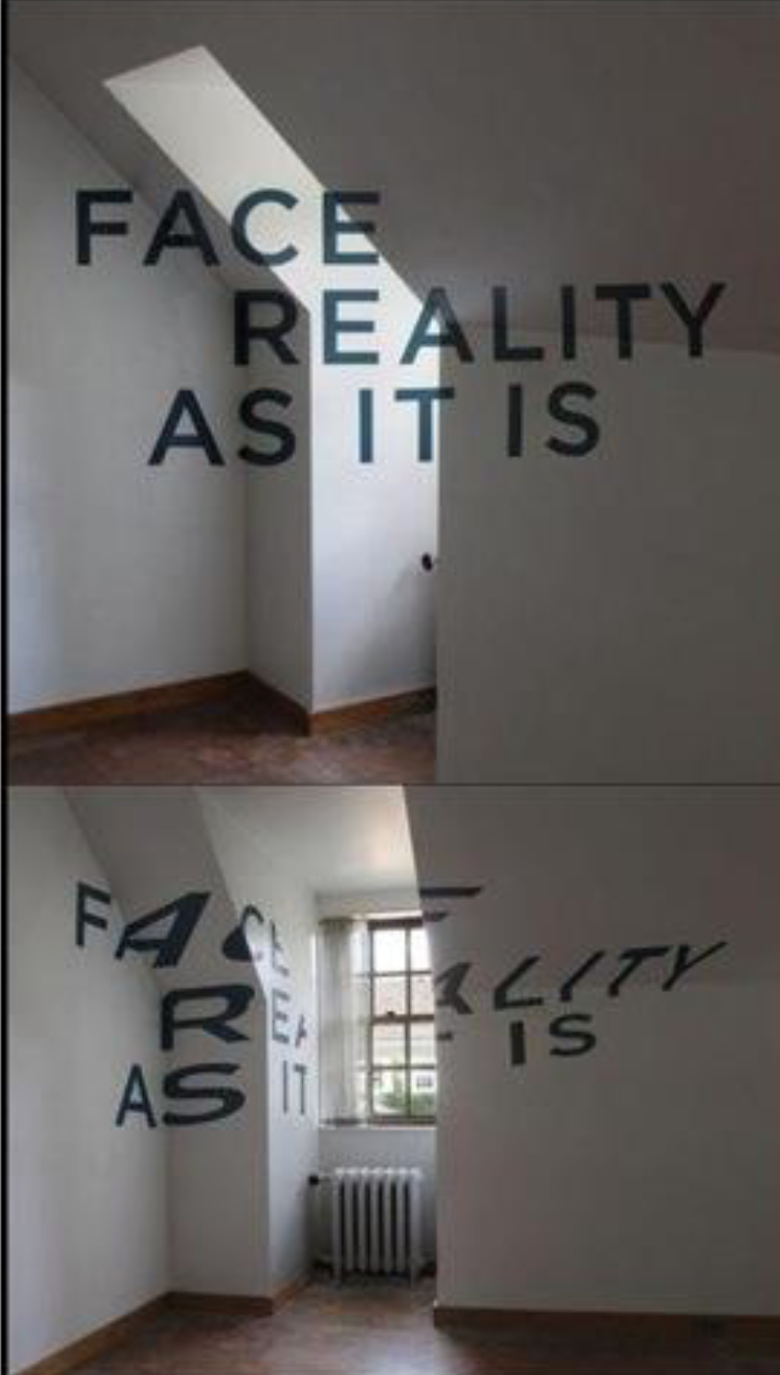
Walk by Faith Not by Sight
Christians must be careful of trusting their sight more than faith.
Faith is the evidence of things not seen (Heb 11:1). Physical sight often acts in opposition to faith because of the lust of the flesh, lust of the eyes, and the pride of life.
Christians see how the ungodly enjoy their sin. Physical vision might be manipulated to says that faith is a lie. Sight is typically focused on Satan's worldly trinkets.
Faith sees through the eternal prism – seeing life in the goal of seeking God.
When focused on this world, Christians are being guided by the values of their former, carnal person. Christians need to walk in faith instead, focused on Christ.
Those trinkets are the desires of the flesh and eyes and the ego. When we set those aside and refocuses our eyes on the eternal, the unseen realm of heaven, then we can walk towards the goal in the light of Christ. The Christian's goal is not on the fleshly things but on the eternal.

Slide 16
Walk by Faith Not by Sight
The Christian soldier's orders are clear in 2 Corinthians 10:3-5: “For though we walk in the flesh, we do not war after the flesh: (For the weapons of our warfare are not carnal, but mighty through God to the pulling down of strong holds;) Casting down imaginations, and every high thing that exalteth itself against the knowledge of God, and bringing into captivity every thought to the obedience of Christ....”
The mind is the battleground of this war. Satan seeks to destroy while God seeks to transform His children into the “light,” the image of His Son.
This spiritual warfare requires Christians to bring their thinking to the obedience of Christ.
The Christian's work is to share God's light and love.
To see the battleground, Christians must focus their view and thinking with the eternal prism – using the spiritual value system as opposed to a carnal value system.

Slide 17
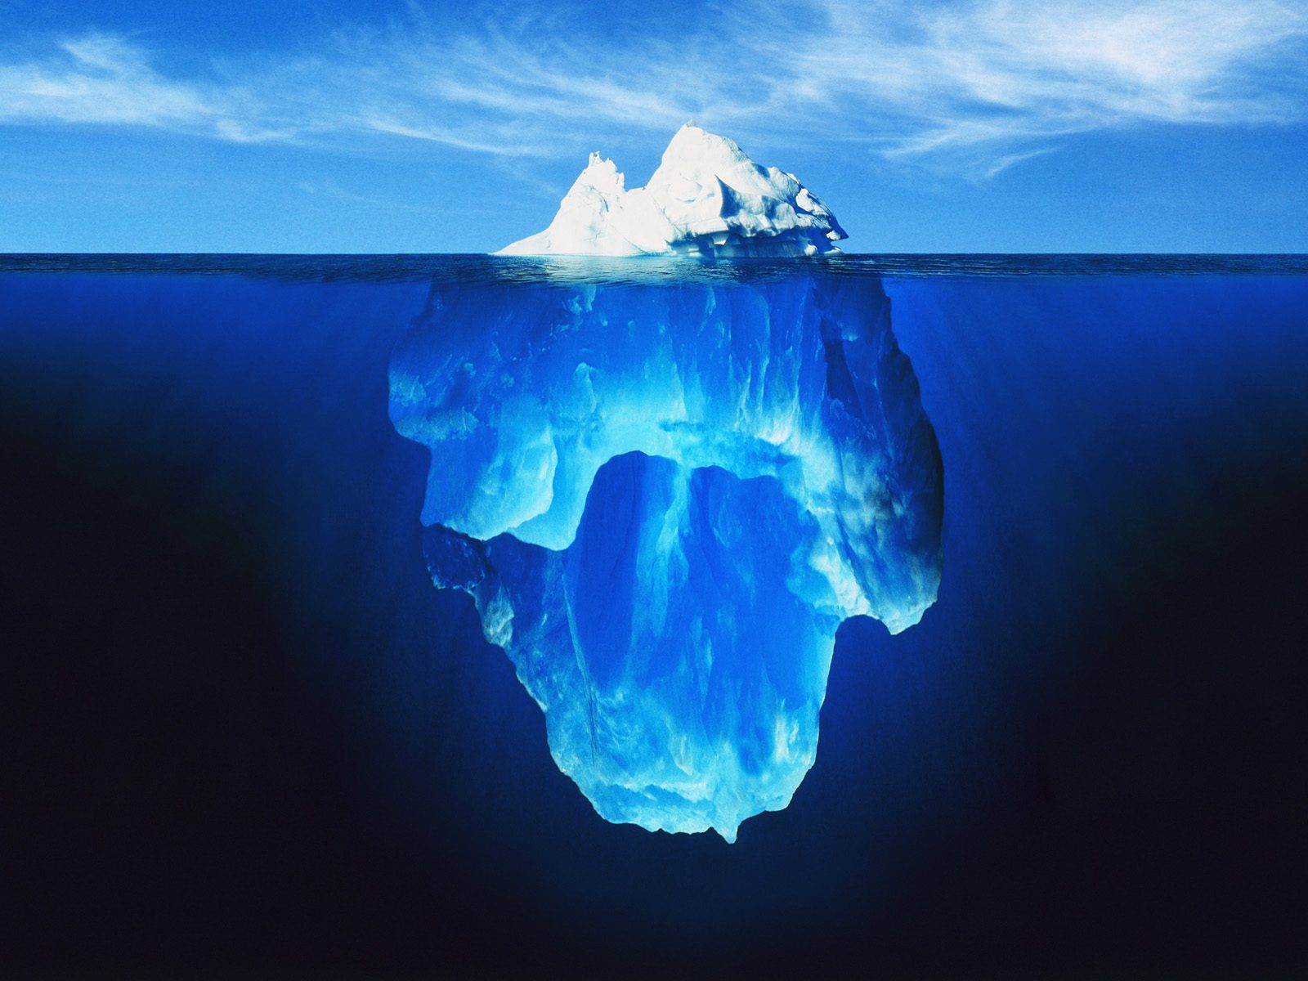
Temporal Versus Eternal Seen Versus Unseen
Faith is the evidence of things not seen (Hebrew 11:1).
The “children of light” have a different perspective than the natural human.
They seek to build a life on the eternally significant, pleasing God, living with a perception of the eternal which the natural person cannot see as anything but foolish.
Hebrews 12:1 challenges the child of God to fix their eyes on Jesus.
2 Corinthians 4:17-18 instructs: “For our light affliction, which is but for a moment, worketh for us a far more exceeding and eternal weight of glory; While we look not at the things which are seen, but at the things which are not seen: for the things which are seen are temporal; but the things which are not seen are eternal.”
The “children of light” seek to lead a life perfecting holiness focused on the eternal rather than the temporal trinkets that Satan uses to dazzle the eyes.

Slide 18

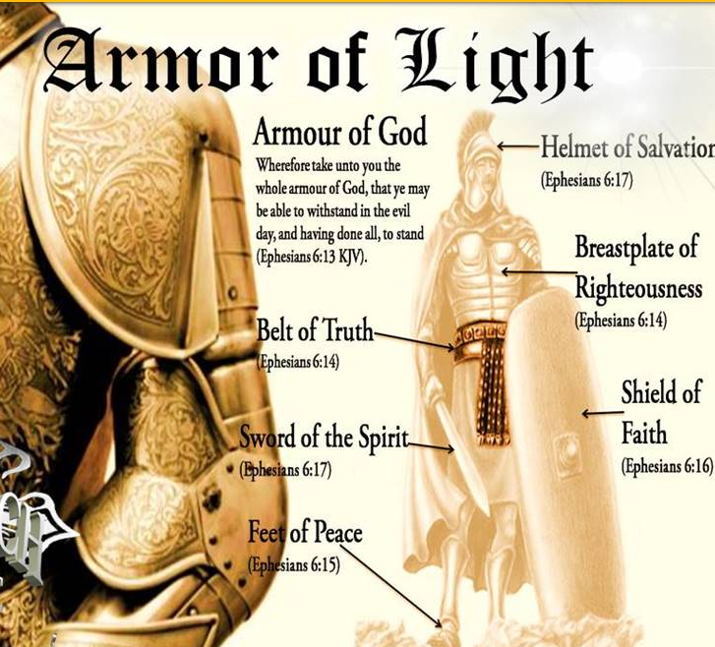
Christian Warfare and Armor of Light
The Christian's warfare is in the mind and heart where they seek to bring every thought to the obedience of Christ.
These weapons are not fleshly but are powerful through God.
Christians walk in the world like all other humans, but they do not seek or war after the carnal. Instead, they seek the eternal (2 Cor 10:3-5).
God has provided truth and instruction in righteousness.
He has provided the gospel, what one needs to grow their faith, salvation, and His word.
Christians must exercise putting on the whole armor of “light” with prayer and perseverance as they wrestle against Satan (Eph 6:11-18)
Put It On

Slide 19
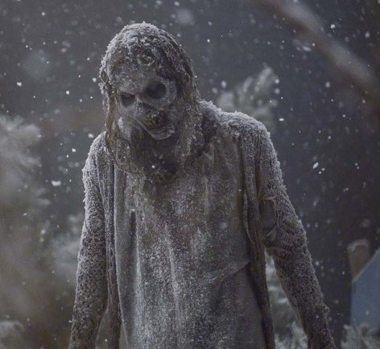
Lift Up Your Eyes
There is a zombie show that is popular on television at this writing called “The Walking Dead.” The characters on the show are constantly meeting the walking dead zombies.
Christians who work and meet others every day are encountering those who are spiritually dead. Their eyes are blinded by Satan, and they cannot see the eternal.
They typically become ensnared and then enslaved to the sin that Satan has used to lie to them.
As a Christian, does one see these folks walking around like the walking dead spiritually?
Children of God can bring them to Christ who can save them.
If someone was facing a disease and a person could heal them, most would try to save that person.

Slide 20
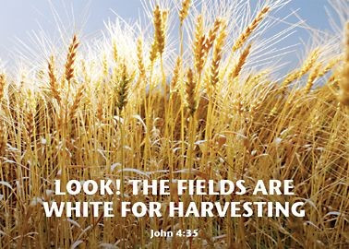
Lift Up Your Eyes
Jesus expressed it this way in John 4:35-36: “Say not ye, There are yet four months, and then cometh harvest? behold, I say unto you, Lift up your eyes, and look on the fields; for they are white already to harvest. And he that reapeth receiveth wages, and gathereth fruit unto life eternal: that both he that soweth and he that reapeth may rejoice together.”
When the crop is ready to be harvested, then it is all hands available. When the harvest is particularly plentiful, there are always too few laborers.
This is also true in God's vineyard (Matt 9:37-38 and Luke 10:2).
Christians must be about the work God has set before them – spreading the gospel. But they will only do so if they see the importance of the eternal and value the lost souls around them that are condemned to hell without the gospel.
The Christian can help God raise those who are spiritually dead to walk in newness of life with God by sharing the gospel.

Slide 21
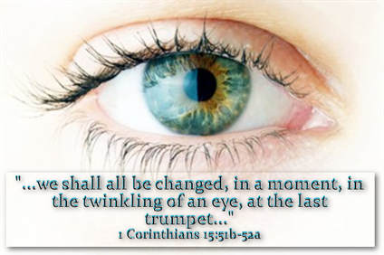
In the Twinkling Of An Eye
There are few guarantees in life. And there is only one certainty: Each human will face death or Christ's return, and thus judgment. It will either be a great day or a day of dread and doom.
Peter challenges Christians who understand Jesus is returning to lead lives of holiness and godliness (2 Pet 3:11-13).
When Christ returns, those who belong to Him will be changed. Then, He will deliver the kingdom to God the Father.
From the perishable, dishonored, natural, and mortal, Christians will be changed into the imperishable, glorified, immortal, and spiritual.
The “children of light” will continue to bear the image of Christ in His victory over sin and death. This all will happen when Christ returns in the twinkling of an eye.
1 Corinthians 15:52 celebrates, “In a moment, in the twinkling of an eye, at the last trump: for the trumpet shall sound, and the dead shall be raised incorruptible, and we shall be changed." With this promise of victory, Paul encourages Christians to be “steadfast, unmovable, always abounding in the work of the Lord.”

Slide 22
Conclusion
In the previous lesson, we learned part of the light story.
In the beginning, God created light.
God is light.
Light is multifaceted and many splendored. It is quiet, unhurried, and powerful.
Since the Garden of Eden, Satan has been deceiving humanity's eyes and ears with his lies, such that human eyes are darkened.
Christ came to cure spiritual blindness and open eyes to see the spiritual rather than the temporal.
Once one can focus and make their eyes single, then these “children of light” must keep their focus on Christ and God.
Jesus healed the blind then, and He cures spiritual blindness now.
Let us continue the story of light.

Slide 23
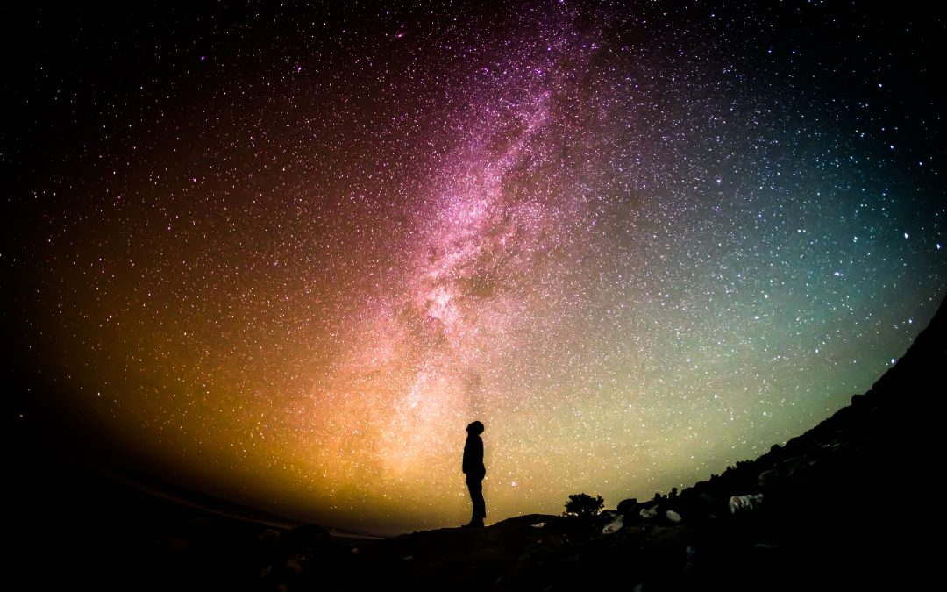
Conclusion
Christians must carry and reflect God's light while perfecting holiness in their lives.
This requires bringing all in obedience to Christ while battling the blind spots of sin.
Christians must be careful not to trust the carnal eye, but to walk by faith instead of sight.
This requires looking to the eternal and not the temporal.
The Christian wants to share the gospel, trying to save all in the harvest that is for eternity.
Jesus will come again in the twinkling of an eye.

